Slide 1
SCC211 Operation System
(Condition Synchronization)
Zhang Jinyu – zjy@bjtu.edu.cn
School of Computer and Information Technology
SD408

Slide 2

Objectives
互斥+有序
Cooperative concurrency management
Condition synchronization
Java wait() and notify()
Semaphores

Slide 3
Condition Synchronization
Merely making put() and get() synchronized methods is not enough!
The crux of the problem is there is no control over the ordering of calls to put() and get()
Depending on appropriate conditions a thread may need
to block on entering an object’s methods
or to unblock previously-blocked threads
In Java this is all based in wait(), notify() and notifyAll()
put和get无法保证有序

Slide 4
wait() & notify()
As mentioned before, only called when the (hidden) per-object lock is held on target object (via synchronized)
– Call without the lock being held raises IllegalMonitorStateException
Object.wait()
– Suspend the called thread and place it on target object’s wait queue
– Release the object lock on the target, let caller retain any other locks
Object.notify()
– If exists, take thread(s) from object wait queue and make it runnable
– Must obtain target’s object lock before resuming
Object.wait ()
-挂起被调用的线程，并将其放在目标对象的等待队列中．
-释放目标上的对象锁，让调用者保留其他锁
Object.notify ()．
-如果存在，从对象等待队列中取出线程并使其可运行
．-恢复前必须获得目标的对象锁
有序的关键是等待队列
May only be used inside synchronized blocks

Slide 5
Continue
Use Boolean variables and expressions to define the conditions
Protect all condition variables by manipulating them only in synchronized methods
If a method call needs to be blocked because a condition is not yet true, the calling thread calls wait()
If a method’s code makes a condition true on which other threads may be waiting, the calling thread calls notify() or notifyAll()

Slide 6
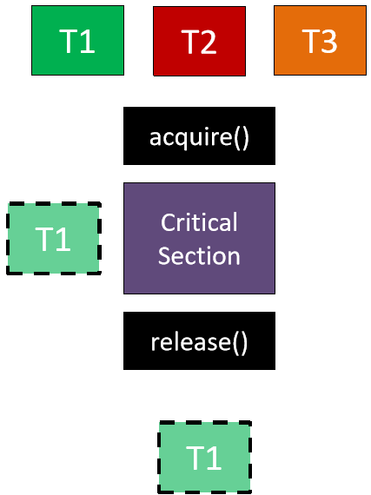
Program
public class Dimension
{ private int dim = 0;
private boolean done_put = FALSE;
public void synchronized put(int d)
{ dim = d; done_put = TRUE;
notify(); }
public int synchronized get() {
if (!done_put)
wait();
return dim; }
}
互斥
有序

Slide 7
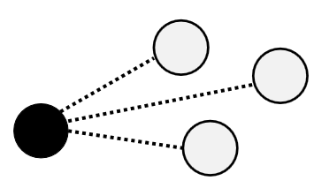
notifyAll()
更好选择，但低效
Similar to notify(), except that the notify() steps are carried out an all waiting threads, not just a single thread
notifyAll() often a better choice than notify()
If condition is set which should allow only particular threads to resume from wait()
Using notify() rather than notifyAll() may cause problems (e.g. deadlock)
However using notifyAll() is less efficient than notify()
notify() should only be used where efficiency is very important and the scheduling issue have been carefully considered

Slide 8
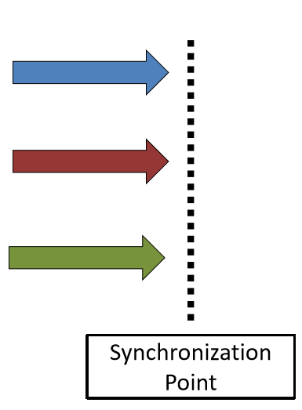
Barrier
考试题
Synchronization method:
processes cannot proceed until other threads reach the barrier
Barrier
进程到barrier前等待，直到所有到齐

Slide 9
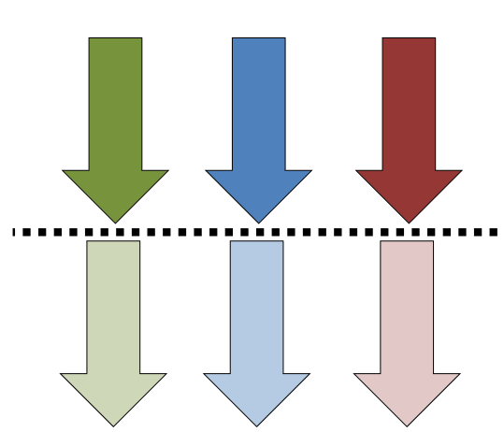
Counting Barrier
count = i;
reduce(count) //atomically
if(count == 0)
{ count = i; }
else { while(count > 0);
//spin
}
起始:count=3
第一个：cout=2,进入while
第二个：cout=1 进入while
第三个：count=0 第一，二个跳出while,
一个一个放

Slide 10
Barrier Code
实现有序执行
public class Barrier {
public void synchronized pause() {
wait(); }
public void synchronized resume_one(){
notify(); }
}

Slide 11
Spurious Wakeup
public class Semaphore {
private int count = 0;
public Semaphore(int init_val){
count = init_val; }
public synchronized void P() {
count = count - 1;
if (count < 0) wait(); }
public synchronized void V() {
count = count + 1;
notifyAll();
}
}
Thread 1
Thread 2
Thread 3
Does not recheck the condition

Slide 12
Priority-based Barrier
What if we want a variation on the barrier that enables to resume only the thread with the highest priority?
public class Barrier {
int highest = 0;
int next_highest = 0;
public void synchronized pause() {
int p;
if ((p = get_priority()) > highest) {
//Compare thread priorities
next_highest = highest;
highest = p; }
else if (p > next_highest)
{ next_highest = p; }
do wait () while(p < highest);
highest = next_highest;
/*set highest for next time */ }
/* Resume the paused thread with the highest priority */
public void synchronized resume_highest_priority() {
notifyAll(); }
}
坏处：虚假唤醒

Slide 13
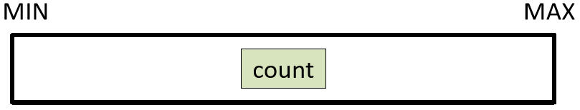
Bounded Counter
滤波器
public interface IBoundedCounter {
public static final long MIN = 0;
public static final long MAX = 10;
public long value(); // initial condition: value()==MIN
// invariant: MIN<=value()<=MAX
public void inc(); // allow only when value()<MAX
public void dec(); // allow only when value()>MIN
}
相当于常量

Slide 14
public class BoundedCounter implements IBoundedCounter {
long count = MIN;
public synchronized long value() {return count;}
public synchronized void inc() {
while(count == MAX) wait();
if (count++ == MIN) // notify if we were in ‘min’ state
notifyAll(); // ... let any blocked decrementer resume }
public synchronized void dec() {
while(count == MIN) wait();
if (count-- == MAX) // notify if we were in ‘max’ state
notifyAll(); // ... let any blocked incrementer resume }
}
睡眠
确保cout始终在[MIN,MAX]中

Slide 15
Cond. Sync. with Semaphores
Use a semaphore initialised to an appropriate initial value (here, the appropriate value is 1)
public class Dimension {
private int dim = 0;
Semaphore s = new Semaphore(1);
public void synchronized put(int d) {
dim = d;
s.wait(); // notify the condition }
public int synchronized get() {
s.signal(); // wait for the condition
return dim;}
}
提前放一个任务
实现互斥
-1
+1

Slide 16
Another Semaphore Example
考试题
class BoundedBuffer {
private Vector buf = new Vector();
private Semaphore mutex = new Semaphore(1);
private Semaphore space_avail = new Semaphore(10); //剩余空间
private Semaphore item_avail = new Semaphore(0);
public void put(int item) {
space_avail.wait(); //-1
mutex.wait();
buf.addElement(item);
mutex.signal();
item_avail.signal(); } //+1
public int get() {
item_avail.wait(); -1
mutex.wait();
int item = buf.removeElementAt(0); mutex.signal();
space_avail.signal();
return item; }
}
容器
实现互斥
顶部
实现有序
sqace+item=10
Note
Can’t we simply use a binary semaphore?

Slide 17
Javas concurrency management, semaphores
Both are complete solutions to concurrency management
(as is message passing)
最安全，没有互斥
Java approach (i.e.synchronized/ wait()/ notify()/ notifyAll()
Language specific, good for object-oriented environments
Semaphore approach
Can be added to any language as library routines
Found in many programming environments
However, bit unstructured and low-level
Can easily confuse mutual exclusion and condition synchronization
Programmer must ensure that semaphore calls ‘match up’
条件同步=互斥+有序
For mutual exclusion, we may need many P()/V() pairs scattered throughout the code (wherever a given shared variable is accessed)

Slide 18
Summary
Cooperation is managed through condition synchronization
Condition synchronisation in Java uses wait(), notify() and notifyAll()
This is in conjunction with the synchronized keyword that gives us mutual exclusion
When initialized, semaphores can do condition synchronization as well as mutual exclusion
Message passing can also do this; message passing implementations are usually not quite so efficient…

Slide 19
Question？

